Slide 1
MOVIE RENTAL ANALYTICS DASHBOARD
Power BI Project using Sakila DVD Rental Database

Slide 2
Project Overview
• Introduction
• Dataset Overview
• Data Modeling & Relationships
• Customer Analytics
• Film Analytics
• Sales Analytics
• Inventory & Staff Analytics
• Key Findings
• Conclusion

Slide 3
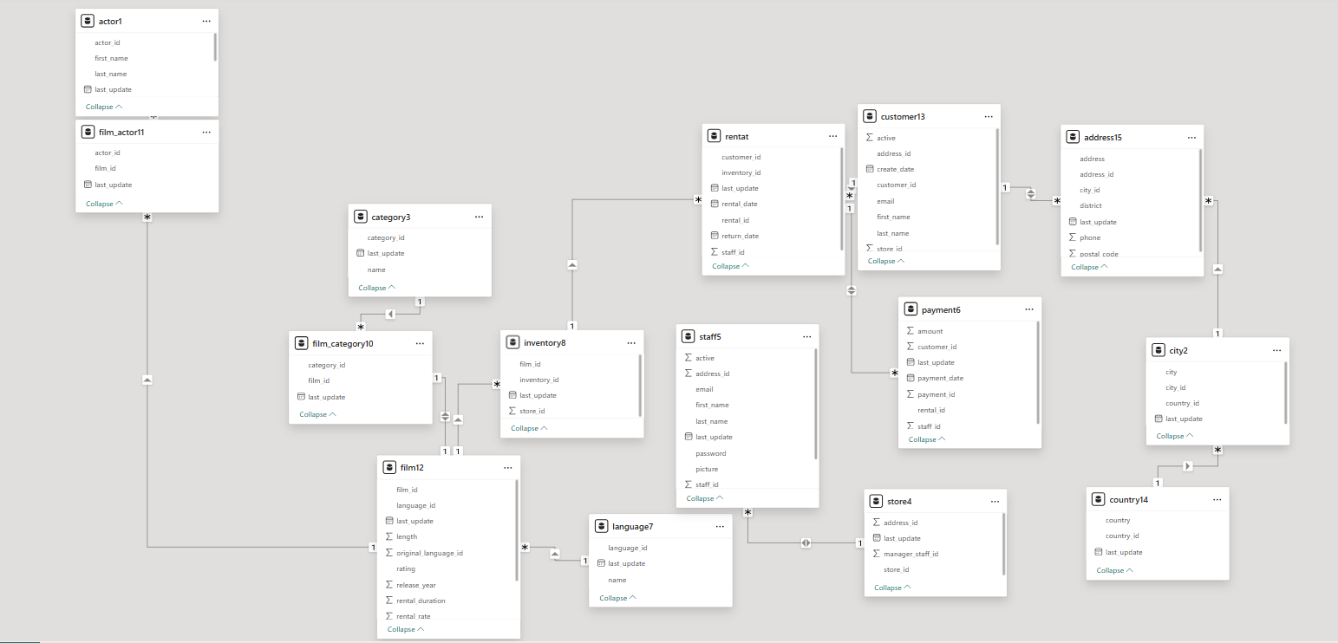
Data Modeling & Relationships
The Sakila database follows a relational data model connecting customers, rentals, payments, films, categories, inventory, staff, and store information.
Key Relationships:
• Customer → Rental → Payment
• Film → Inventory → Rental
• Film → Film Category → Category
• Film → Language
• Customer → Address → City → Country
• Store → Staff
The data model enables efficient analysis of revenue trends, customer behavior, inventory management, and geographical insights.

Slide 4
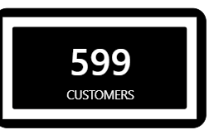
CUSTOMER ANALYTICS
This analyzes customer behavior, rental patterns, and customer contribution to revenue.
Key Insights:
• Top customers generated the highest rental revenue.
• Customer distribution varies across countries and cities.
• Repeat customers contributed significantly to total rentals.
• Revenue contribution is concentrated among a small customer segment.
Visuals Included:
• Customer Revenue Analysis
• Top Customers by Revenue
• Country-wise Customer Distribution
• Customer Segmentation

Slide 5
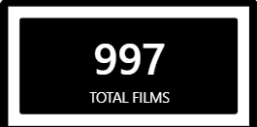
FILM ANALYTICS
This focuses on film performance, category analysis, rental duration, and inventory insights.
Key Insights:
• Certain film categories generated higher rental revenue.
• Popular films had higher rental frequency.
• Rental duration varied significantly across categories.
• Inventory distribution differed by film category.
Visuals Included:
• Film Category Analysis
• Rental Duration Comparison
• Film Language Distribution
• Inventory Breakdown
• Top Performing Films

Slide 6
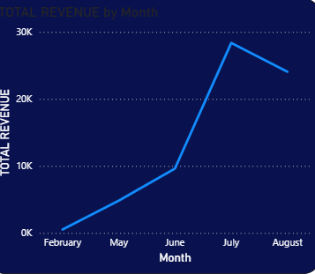
Sales Analytics
This analyzes revenue trends, monthly sales performance, and regional revenue distribution.
Key Insights:
• Monthly revenue trends revealed seasonal fluctuations.
• Revenue performance differed across countries.
• Certain categories generated higher average rental rates.
• Rental revenue increased with repeat customer activity.
Visuals Included:
• Monthly Revenue Trend
• Revenue by Country
• Category Revenue Analysis
• Average Rental Rate Comparison

Slide 7
INVENTORY & STAFF ANALYTICS
This evaluates inventory availability, store performance, and staff contribution analysis.
Key Insights:
• Inventory distribution varied across categories.
• Staff performance impacted rental processing efficiency.
• Store performance differed by location.
• Inventory availability influenced rental frequency.
Visuals Included:
• Inventory Distribution
• Store-wise Analysis
• Staff Performance Metrics
• Location-Based Insights

Slide 8
KEY FINDINGS & INSIGHTS
• Repeat customers contributed significantly to total revenue.
• Action and Sports categories showed high rental demand.
• Monthly revenue trends highlighted peak rental periods.
• Revenue distribution varied across countries and cities.
• Inventory availability directly influenced rental frequency.
• Customer behavior patterns supported targeted marketing opportunities.
• Power BI dashboards enabled interactive business performance analysis.

Slide 9
Tools & Technologies Used
• Power BI
Data Visualization & Dashboarding
• MySQL
Data Querying & Analysis
• Excel
EDA & Data Handling
• PowerPoint
Presentation & Reporting

Slide 10

Conclusion
The Sakila Movie Rental Analytics project successfully transformed raw relational data into meaningful business insights using Power BI.
The dashboard provided comprehensive analysis of customer behavior, sales trends, film performance, inventory management, and regional business performance.
The project demonstrates how data visualization and business intelligence tools can support informed decision-making and improve operational efficiency.

Slide 11
Thank you
Udita Sarkar
uditasarkar9@gmail

